Slide 1
Essential Question:
What were the demands of the various “power movements” of the 1960s & 1970s?
Use the slides below to fill in the blanks on the right hand column of the Power Movements chart

Slide 2
Black Power: SNCC & the Black Panthers

Slide 3
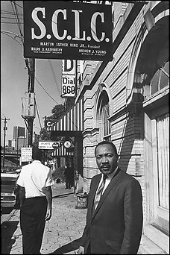
Black Power
By 1965, African American civil rights leaders helped bring an end to segregation & voting restrictions
After MLK’s death in 1968, the civil rights movement turned from non-violence to…
Notes:
militant action & demand for economic equality

Slide 4
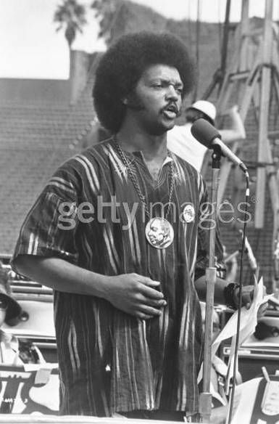
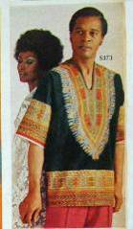
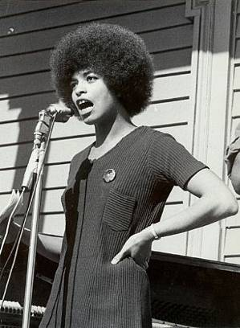
Black Power
…embracing African culture & black pride (“Black is beautiful”)
Notes:
militant action & demand for economic equality

Slide 5
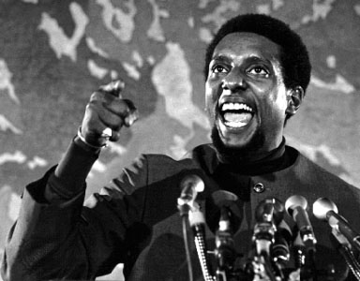
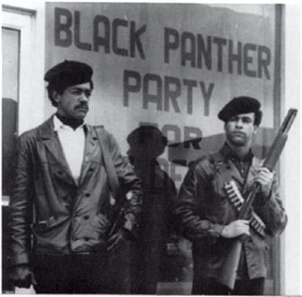
Black Power
…creating economic opportunities through black nationalism (Black-owned businesses) & militant action to protect African Americans
The leading “Black Power” groups were SNCC under Stokely Carmichael & the Black Panthers
Notes:
militant action & demand for economic equality

Slide 6
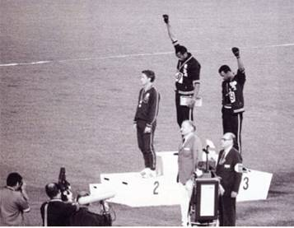
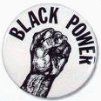
1968 Mexico City Olympics Tommie Smith & John Carlos

Slide 7
Yellow Power: Asian American Movement

Slide 8
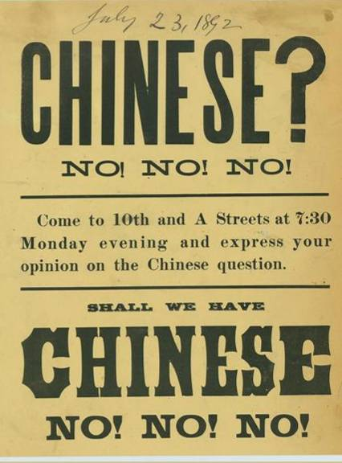
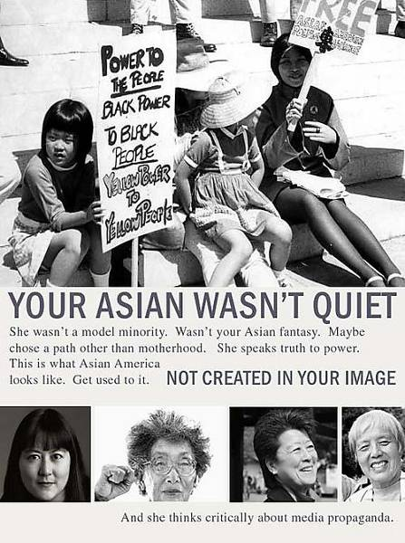
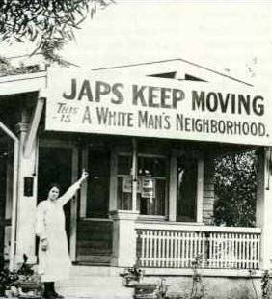
“Yellow Power”
Asian Americans faced discrimination in the U.S. (Chinese Exclusion Act, Japanese internment during WWII, anti-Asian attitudes due to Vietnam)
Pan-Asian groups gained Asian-American studies programs in colleges, health services in Asian communities, & reparations for interned Japanese-Americans
Notes:
movement began with the formation of the Asian American Political Alliance:
Protested U.S. involvement in Vietnam & use of term “gooks”

Slide 9
Brown Power: Chicanos, Cesar Chavez, & the United Farm Workers

Slide 10
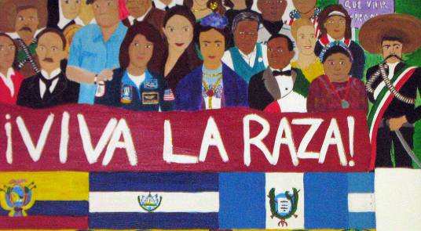
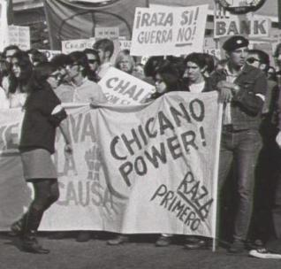
“Brown Power”
Mexican American groups worked to improve the lives of “Chicanos”
Embraced Mexican heritage (“La Raza”) & fought for voter registration, poverty reforms, & bilingual education programs

Slide 11
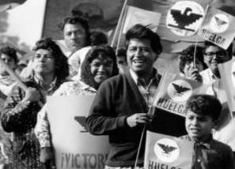
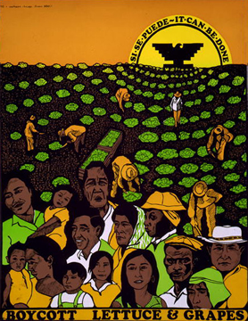
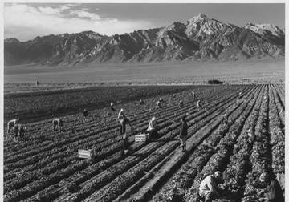
“Brown Power”
Mexican American groups worked to improve the lives of “Chicanos”
César Chávez organized the United Farm Workers & helped gain better pay, union recognition, & better working conditions for farm laborers

Slide 12
Rainbow Power: The Gay Liberation Movement

Slide 13
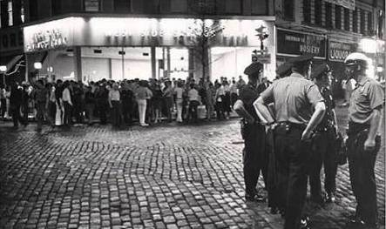
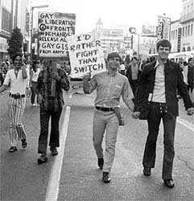
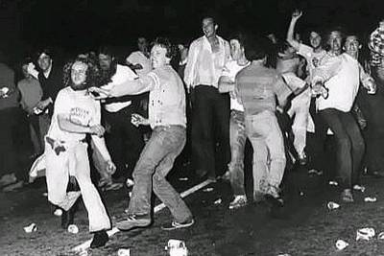
“Rainbow Power”
The Gay Liberation movement started in 1969 after a police raid at the Stonewall Inn led to riots in New York City

Slide 14
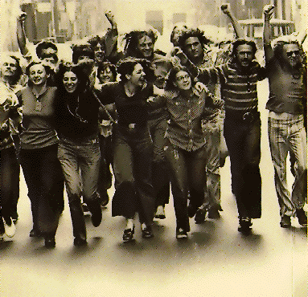
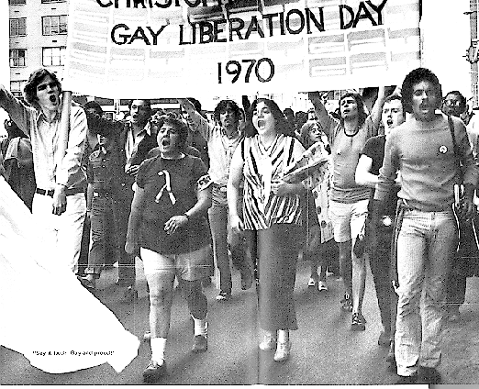
“Rainbow Power”
The Gay Liberation Front (GLF) was formed to bring an end to discrimination against homosexuals
The GLF emphasized “gay pride” & encouraged people to “come out of the closet”

Slide 15
Red Power: The Native American Movement

Slide 16
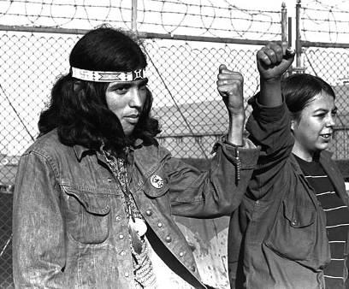
Red Power
By the 1960s, Native Americans had the lowest income, highest unemployment rate, & shortest life expectancy of any group of Americans
Indian groups began demanding tribal autonomy & the return of lands taken by broken treaties with Indian tribes
Notes:
By the 1960s, American Indians had the lowest income, worst health, highest suicide rate, shortest life expectancy and highest unemployment rate of any minority group in the United States. Native American activists tried to draw attention to these conditions by suing the federal government and organizing protest marches to demand Indian autonomy and the return of Indian lands lost because of broken treaties. In 1969, 78 Indians occupied Alcatraz Island in San Francisco Bay; in 1972 the militant American Indian Movement (AIM) occupied the Bureau of Indian Affairs in Washington, DC; and in 1973, 200 armed AIM members took control of Wounded Knee in South Dakota, the site of the 1890 massacre of Indians. In each of these protests, American Indians brought attention to their cause.

Slide 17
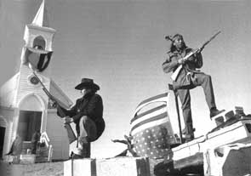
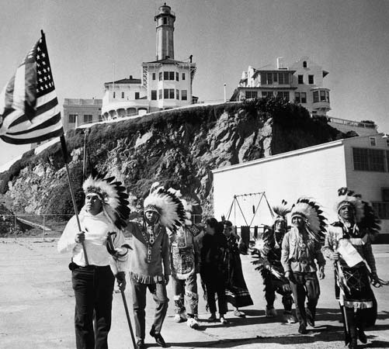
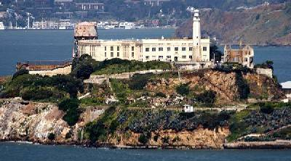
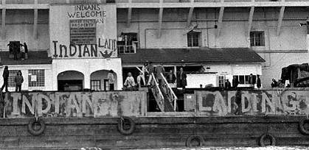
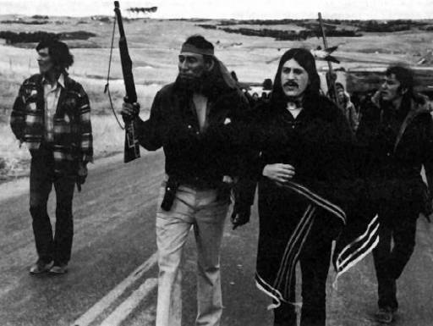
Red Power
In 1969, a group of 78 Native Americans seized Alcatraz Island in San Francisco
In 1973, 200 armed Indians took control of Wounded Knee in South Dakota, the site of the 1890 massacre of Indians
Notes:
By the 1960s, American Indians had the lowest income, worst health, highest suicide rate, shortest life expectancy and highest unemployment rate of any minority group in the United States. Native American activists tried to draw attention to these conditions by suing the federal government and organizing protest marches to demand Indian autonomy and the return of Indian lands lost because of broken treaties. In 1969, 78 Indians occupied Alcatraz Island in San Francisco Bay; in 1972 the militant American Indian Movement (AIM) occupied the Bureau of Indian Affairs in Washington, DC; and in 1973, 200 armed AIM members took control of Wounded Knee in South Dakota, the site of the 1890 massacre of Indians. In each of these protests, American Indians brought attention to their cause.

Slide 18
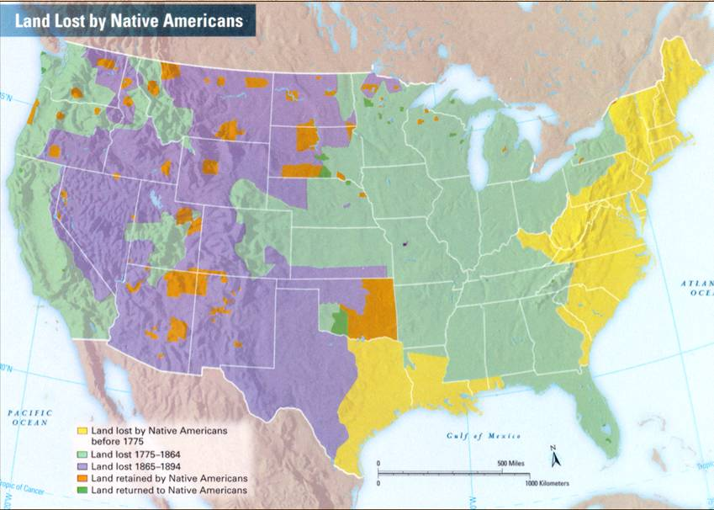

Slide 19
Pink Power: The Women’s Movement

Slide 20
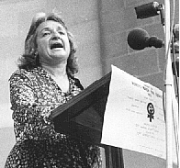
Pink Power
Betty Freidan began the modern women’s movement by publishing Feminine Mystique in 1963

Slide 22
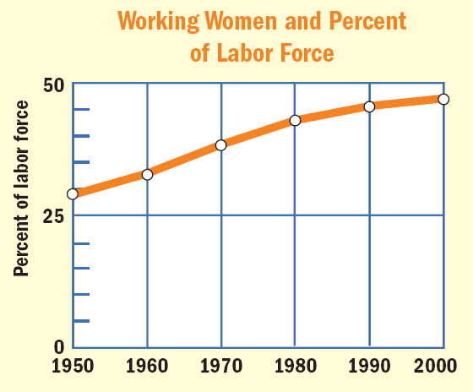
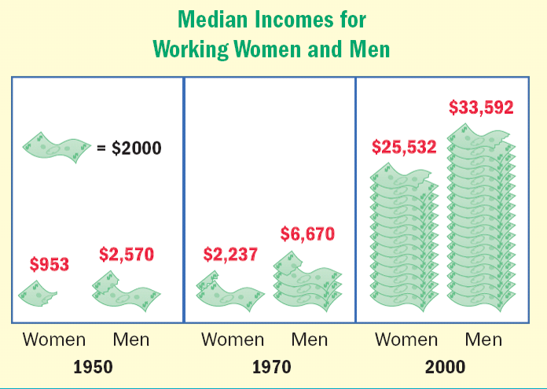
Pink Power
Feminists drew attention to sexual discrimination & unequal pay for women

Slide 23
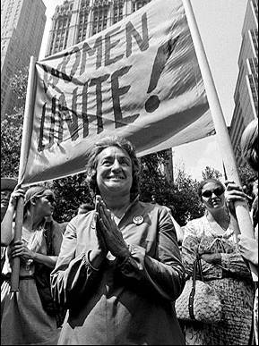
Pink Power
Feminists drew attention to sexual discrimination & unequal pay for women
Betty Freidan co-founded the National Organization of Women (NOW) to advocate for women

Slide 24
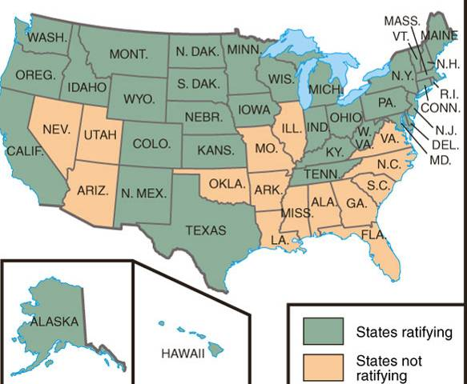
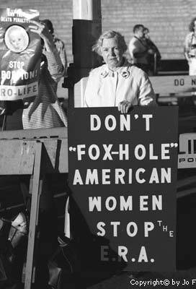
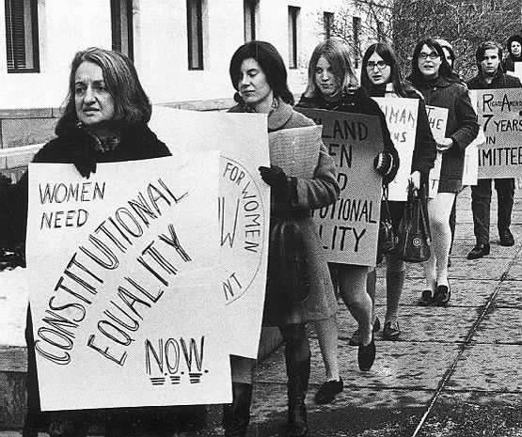
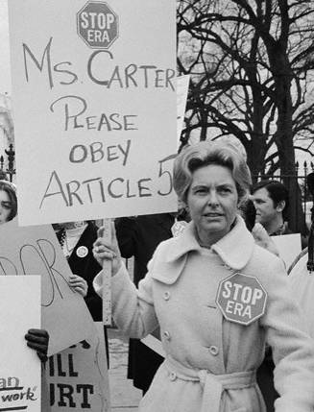
Pink Power
The leader of the anti-ERA movement was Phyllis Schlafly who believed that women were protected by the Civil Rights Act
Feminists drew attention to sexual discrimination & unequal pay for women
Feminists demanded an Equal Rights Amendment (ERA) to ban sexism
The ERA was defeated in the 1970s by conservatives & anti-ERA women

Slide 25
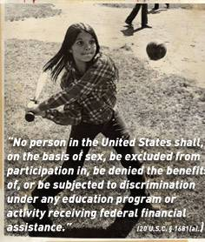
Pink Power
But, the women’s movement did have successes
Gained abortion rights in Roe v Wade (1973)
Congress passed Title VII to protect women from sexual harassment
Congress passed Title IX that outlawed sexual discrimination in education programs

Slide 26
Green Power: The Environmental Movement

Slide 27
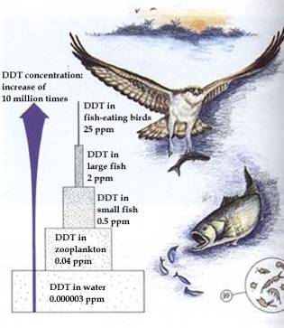
Green Power
Earth Day is celebrated each year on April 22
In 1962, biologist Rachel Carson published Silent Spring exposing the dangers of pesticides on the environment
By 1970, the government passed clean air & water laws, created the Endangered Species Act & formed the Environmental Protection Agency (EPA)
Notes:
. She had become concerned during the 1950s at the rapid increase in pesticides by farmers and government agencies. Reaction to her book led the government to organize an investigation of the industry and sparked the environmental movement. In 1970, the government created the Environmental Protection Agency (EPA) The United States also passed new legislation such as the Clean Water Act, the Clean Air Act, the Endangered Species Act, and the National Environmental Policy Act- the foundations for current environmental standards.

Slide 28
Do Now
Complete Guided Reading 32-1/32-2 on the Nixon presidency
Nixon EdPuzzle

