Slide 1
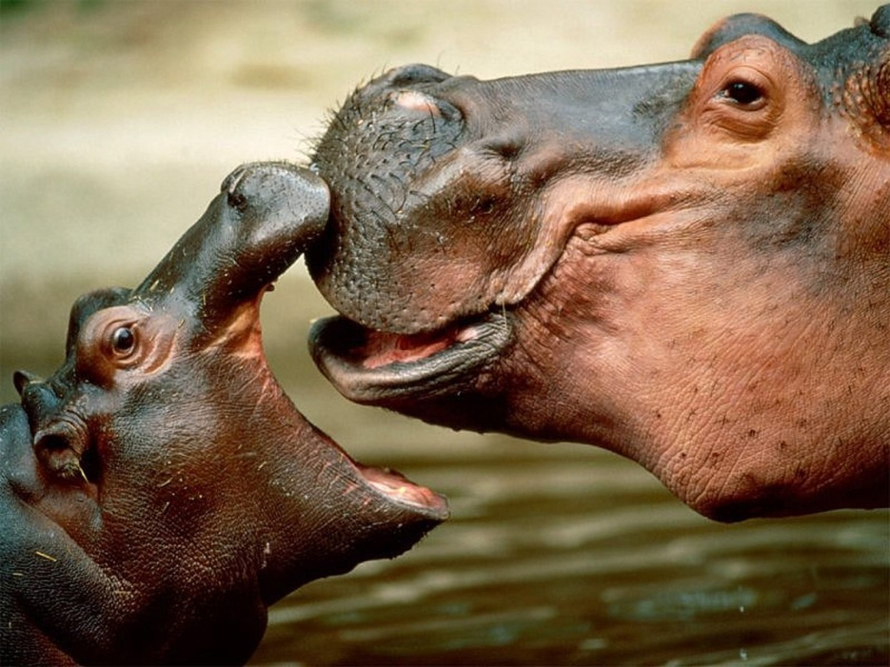
HIPPO
Options for Analyzing Historical Documents

Slide 2
WHAT THE HECK IS HIPPO?
HIPPO is a method for analyzing documents. The DBQs require that you analyze documents in order to achieve the maximum score possible.
While you won’t have time to analyze every document on a DBQ for each of the HIPPO options, you will gain practice in how to analyze by fully completing HIPPO sheets for primary and secondary source documents as we progress through the course.

Slide 3
Historical Context
Where and when was the source produced? How might this affect the meaning of the source? Writing down the date and place is important but ONLY doing that DOES NOT demonstrate analysis.
What was happening during the time period and just before the time period and what might that tell you about the document? This is where you should drop some knowledge (evidence/outside information/key vocab) that you learned in the textbook and other articles you have read in this class. I can generally tell who has been reading and who hasn’t based on the prior knowledge analysis they analyze.
Consider the context in which the source was created. What do you know that would help you further understand the document? For example, if a political cartoon, do you recognize any symbols and recall what they represent?

Slide 4
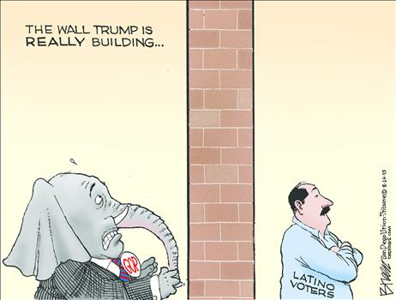
Historical Context example
What is the historical context?
What happened before that led to this?
Any symbols that you recognize?

Slide 5
Intended Audience
For whom was the source created and why does the audience matter for the document?
In some cases, the document may not explicitly state the intended audience, but you can normally infer this based on the way the document was written.

Slide 6
Intended Audience example
“This great Nation will endure as it has endured, will revive and will prosper. So, first of all, let me assert my firm belief that the only thing we have to fear is fear itself—nameless, unreasoning, unjustified terror which paralyzes needed efforts to convert retreat into advance. In every dark hour of our national life a leadership of frankness and vigor has met with that understanding and support of the people themselves which is essential to victory. I am convinced that you will again give that support to leadership in these critical days.”
-President Franklin D. Roosevelt, from his 1933 Inaugural Address
Who is the intended audience? Why would he be addressing them at this time?

Slide 7
Point of View
Who created the source?
What do you know about the author?
What is the author’s point of view? What are the author’s biases? Simply stating a document is biased, or that an author is pro-___ isn’t enough…needs to tie to your argument.
In what ways might the author’s gender or profession effect reliability of the source?
Writing down the author’s name is important but ONLY doing that DOES NOT demonstrate any analysis.

Slide 8
Point of View example
“I have here in my hand a list of 205 [State Department employees] that were known to the Secretary of State as being members of the Communist Party and who nevertheless are still working and shaping the policy of the State Department.”
-Senator Joseph McCarthy, Feb. 9, 1950, speech to Ohio County Women’s Republican Club in Wheeling, West Virginia
What do you know about the author?
What is the author’s point of view?
What are the author’s biases?
How might the author’s gender or profession effect reliability of the source?

Slide 9
Bias versus Biased
A person who is influenced by bias is BIASED
For example, you could make the argument that Jack Weatherford was biased against Christopher Columbus; his bias was evident in the strongly negative adjectives he used when discussing Columbus and the fact that he did not give any credit to Columbus for his accomplishments
The expression is not “they’re BIAS,” but “they’re BIASED.”
Also, many people say someone is “biased toward” someone when they mean biased AGAINST.
To have a bias toward something is to be biased in its favor.

Slide 10
Purpose
What is the purpose? Why did the author write this? to inform? to persuade? is it propaganda? a political platform? a rationale? a government or other record? a personal diary or journal? to explain? an apology? Etc.
Summarize the author’s point. What point is the source trying to convey? ONLY summarizing the documents is not enough.
Write: “The intent of the author was to convince/explain/propose/etc….”
DO NOT analyze statistics, charts, or graphs for purpose because most of the time you won’t have enough information to know the purpose

Slide 11
Organization/Use in an Argument
Put together Historical Context, Intended Audience, Point of View, and Purpose and consider how it would support the argument proposed in your thesis.
For the purpose of practicing how to apply your document analysis to historical questions, I will provide you with a historical question for the Organization/Use in an Argument section of the HIPPO sheets.

Slide 12
Guidelines for Writing Historical Essays
Stick to the question. Make sure you are answering what is being asked and are sticking to the time scope of the question.
Write concisely. Make conceptual arguments in your essay, provide factual support, and move on. Avoid the temptation to write everything you know or to tell a pleasant story. Remember, you are not writing a history of the period; you are answering a specific question about this period in US history.
Some students pound a single point, incorrectly believing that constant restating adds to an essay. Avoid lengthy discussion of minor or peripheral material. A good essay is not filled with superfluous (unnecessary) detail.
Ask about every sentence: Will this help me communicate my point to the reader? If the answer is no, leave the sentence out.
A concise essay in which every word has a purpose is better than an essay bloated with fillers and flowery language in an attempt to impress the reader. Don't write about a subject; write to persuade.

Slide 13
Don’t use slang terms. A good historical essay does not use slang. Avoid “things”, “stuff”, and “a lot”.
Avoid abstracts. Be careful of abstract words and concepts such as democracy, progress, success, and individualism. Certain abstract words carry a wide range of definitions and connotations. Take the time to define an abstract word or concept; it helps you focus on that aspect of the word the essay question intends.
Use adjectives and adverbs. Use effective adjectives and adverbs to enhance the descriptive power of your essay. These expand and enhance the essay's thesis. For example: "Smith's letter strongly portrayed Jackson's belligerent attitude toward the Bank of the US". Use adjectives to convey the amount of generality or specificity needed for a particular sentence. "The US has a democratic government." Is it a parliamentary democracy, representative democracy, or direct democracy? Do you mean political, economic, social, or religious democracy? Do you mean democratic in results or in opportunity? However, sometimes a single adjective sufficiently describes a noun, e.g., "fascist leaders", or "marginal farmers".

Slide 14
Make a mental and/or written outline. Organization is the key to a good essay. Delay writing your essay until you have had time to organize your thoughts and outlined your answer. Jot down all the concepts and facts pertaining to the answer. Organize these facts into major sections or paragraphs. Then write your essay.
Do not use absolutes. Do not use absolute words - never, all, only, none, every, etc. Rarely in history is the evidence so absolutely conclusive that you can prove that there were no exceptions. At least one point will be deducted on your essays for the use of these words.

Slide 15
Proofread. When you are finished, briefly read your essay. Check for grammatical errors and misspellings.
The omission of one word, particularly the word "not", may change the meaning of your essay. A student occasionally begins an essay with one argument, realizes he has better support for the opposite viewpoint, and changes the remainder of the essay without changing the introduction.
For example, an essay states that slavery was the sole cause of the Civil War by agreeing with the statement in the introduction, but then contradicts that thesis in the body of the essay by discussing multiple causes. Go back and change the introduction.

Slide 16
Assume your reader is uninformed.
Spell things out. Don’t take it for granted that he or she knows what you mean or what you are talking about. You have never met the person who is going to read and grade your essays. Explain your key points clearly; don't assume that people know what you know. When you mention someone in the essay for the first time, include both the first and last name.
Define or explain all key terms. If the question deals with terms, such as “liberal”, “conservative”, “sectionalism”, or “manifest destiny”, an essential part of your analysis should be an explanation of these terms.

Slide 17
Use transition words. A judicious use of transitional words and phrases such as: “therefore”, “however”, “thus”, “despite”, “because”, “instead”, “although”, “rather”, “furthermore”, “nevertheless”, and “finally” carries the reader smoothly from one sentence or paragraph to the next.
Write in the third person. Do not use "I", "me", “we”, or other personal pronouns in order to avoid personal feelings and impressions. You must use historical facts and logical reasoning to support the thesis. At least one point will be subtracted on your essay if you use personal pronouns.

Slide 18
Avoid progress reports. For example, "It is now time to conclude"; "Enough of this"; or "Let's get into it".
Use key words and phrases that indicate judgment and analysis. These might include: controversial, turning point, inevitable, more importantly, ironic, key, significant, primary, secondary, deliberate, dramatic, predominant, imperative, any indicator of degrees of causation, etc. A student who uses judgment/ analysis indicates a higher degree of sophistication than a straight narrative composition that only recites facts. Prioritize your organizational points and indicate primary vs. secondary causation or some aspect of varying degrees of importance for your list. It is rare that anything ever happened or didn't happen due to factors that shared the exact degrees of relevance. Distinguish between the significant and the less important.

Slide 19
Use "wonderful" verbs. The verbs used are a critical element in presenting a more sophisticated and descriptive essay. Your choice of verb reveals your judgment and analysis of the facts. Use a variety of "wonderful verbs", such as revealed, illustrated, implied, demonstrated, portrayed, exemplified, indicated, symbolized, depicted, etc. Compare, for example: "The assassination caused the war..." vs. "The assassination provoked the outbreak of war..." or "The diary showed the prejudice..." vs. "The diary usually illustrated the deep prejudices".
Reduce your use of all forms of the verb "to be" (am, is are, was, were, have been, being, etc.) Change them to more active verbs. Avoid vague verbs such as “felt” and “says”.
Remember! Affect is most commonly used as a verb and refers to the action of influencing something else. Effect is most commonly used as a noun and refers to something that happens because of some action or event.

Slide 20
Use the active voice. Use the active voice rather than the passive voice because it states cause and effect more strongly. “Edison created” is in the active voice; “was created by Edison” is in the passive voice.
Show your awareness of the complexity of history. There are a multiplicity of events, emotions, ideas, etc. that impact human history. Avoid simplistic comments, e.g., something is "bad", "good", "great", "fantastic", etc. Stay away from the idea of single causation.
Write using the PAST TENSE. The events occurred.

Slide 21
Do not use abbreviations. George Washington was not "GW"; Andrew Jackson was not "AJ". However, actual nicknames such as JFK or LBJ are acceptable.
Never write conversationally. Don’t talk to the reader. Never state what you are going to tell the reader. Do not use rhetorical questions.
Spelling and capitalization. Spelling and capitalization; spelling and capitalization!!!!

Slide 22
Do not use metaphors that have no bearing on the issue.
Avoid comments like, “That's why we have the country we do today.” Or “If the Pilgrims had never landed here, we could not have become the great, freedom-loving nation that we are today.”
Watch out for repetitions. Avoid repetitive tendencies in word or phrase usage and sentence structure.
Justify your arguments. Express facts and demonstrate why the reader should believe your conclusions.

Slide 23
Use personal pronouns sparingly. Avoid vague references, such as “them” and “others”. It’s pretty easy to confuse the reader if he or she has to struggle to figure out who “them” is/are/or could be.
Avoid “lumping”. Be cautious about placing too much unity into the thoughts and actions of the many, i.e. “The colonists felt…the Indians hated…the Europeans wanted...the South believed…the North hated…”. Could there be subsets within the groups? Which groups felt, hated or wanted? It’s like saying “all teenagers are…”

Slide 24
Don’t inject yourself into history.
Don’t use “we” when you really mean, “Americans who have been dead for a long time”. “We” didn’t evict the Cherokee from Georgia, win World War I, give women the right to vote, build railroads, land on the moon, etc. The US citizens of the past did.

Slide 25
It’s HIPPO TIME
On my website, open the document John Smith ‘The General Historie of Virginia, New England, The Summer Isles”
Read the document and complete a HIPPO analysis sheet on a GoogleDoc which you should share with me. You are expected to use information you read about in the readings from last night (Pageant Ch. 2 & ATF Ch. 1) to enhance your arguments.
For the ‘O’ consider how the document can be used for the following question:
Analyze the factors behind competition, cooperation, and conflict among different societies and social groups in North America during the colonial period.

