Slide 1
Essential Question:
  What are the differences among the Chesapeake, New England, Middle, & Southern colonies?
Agenda for Unit 1.4:
  “Compare the British Colonies” notes

Slide 2
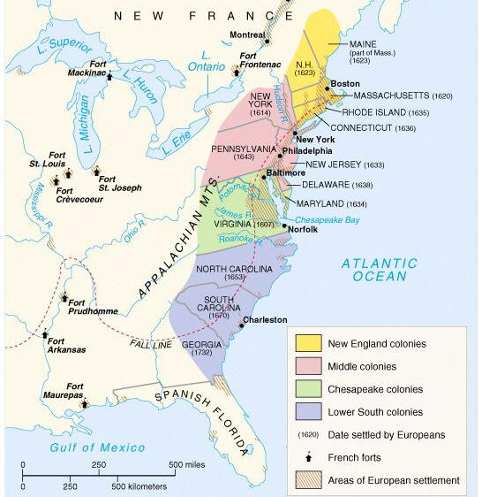
America: The Story of Us
New England (8.44)
Notes:
Describe the settlement of New England; include religious reasons, relations with Native Americans (e.g., King Phillip’s War), the establishment of town meetings and development of a legislature, religious tensions that led to the founding of Rhode Island, the half-way covenant, Salem Witch Trials, and the loss of the Massachusetts charter and the transition to a royal colony.

Slide 3
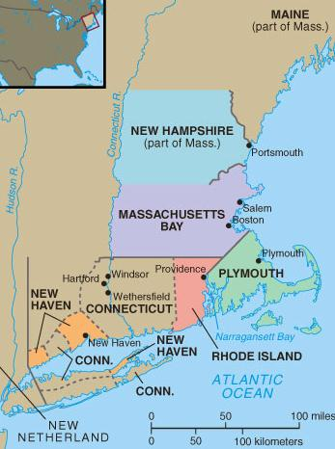
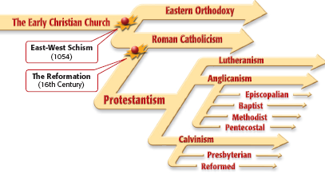
The colonists who first settled in
New England came for religious reasons
Religious disagreements
in Britain led to divisions
in the Anglican Church

Slide 4
Puritans believed in
the Calvinist idea of predestination & tried
to live strictly “Christian” lives without sin
Puritans believed that
the Anglican Church compromised too far
by allowing some
Catholic rituals

Slide 5
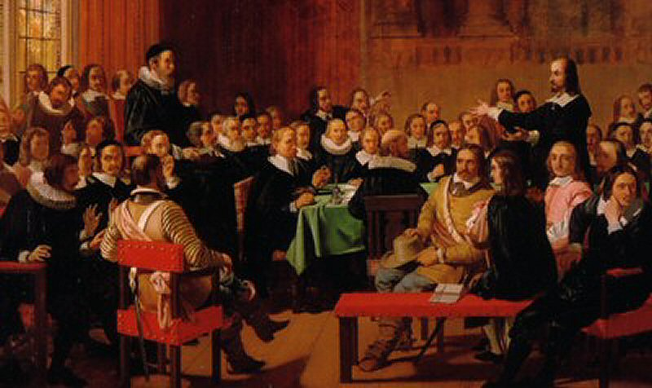
All Anglicans
Puritans
Separatists
Some radical Puritans were known as Separatists because they were unwilling to wait for church reforms

Slide 6
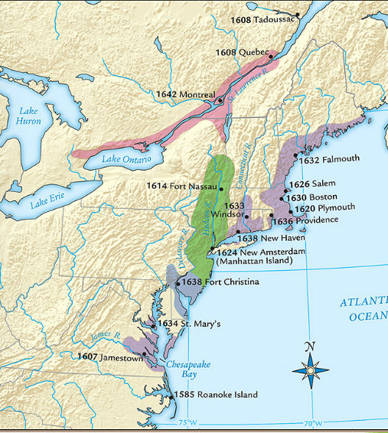
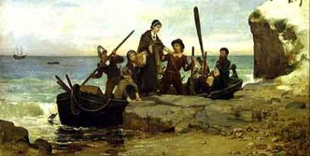
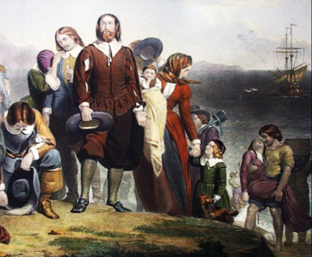
The Separatists became “Pilgrims” when they formed a joint-stock company, gained a charter,
& created the Plymouth colony in America

Slide 7
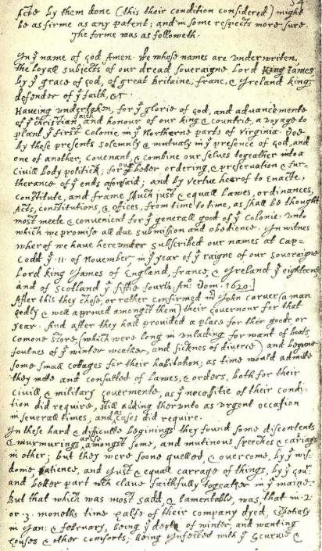
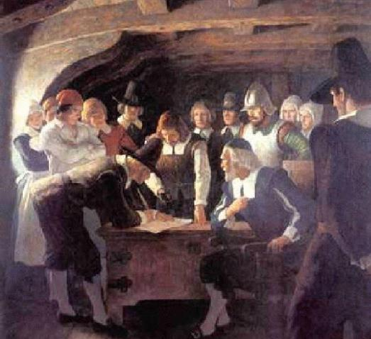
Before landing in America, the Pilgrims created the Mayflower Compact agreeing to work together
as a “civil body politick”…
…The Mayflower Compact was the first example of
self-government in America

Slide 8
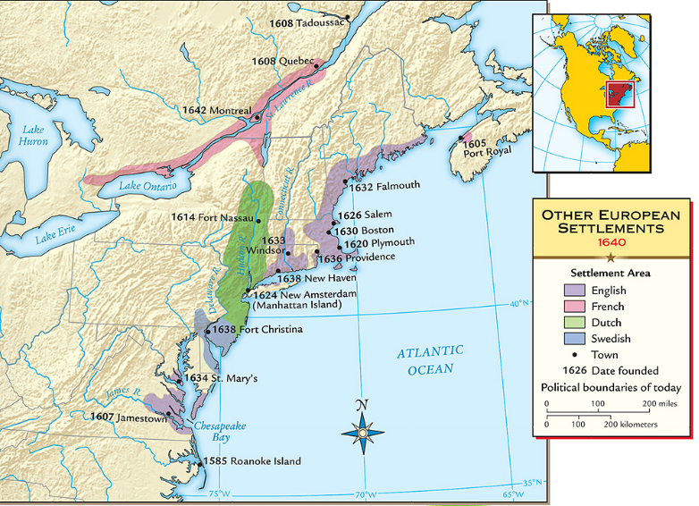
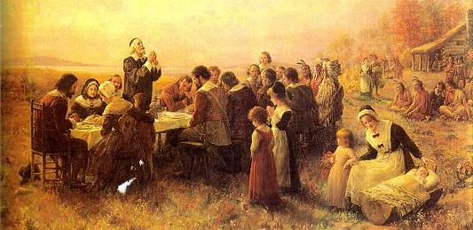
When the Pilgrims founded Plymouth in 1620,
they faced disease & hunger
The Pilgrims received help from local natives like Squanto & Massasoit…
…and celebrated the first Thanksgiving to honor the local Indians

Slide 9
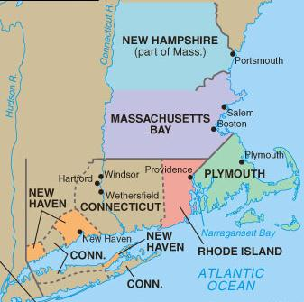
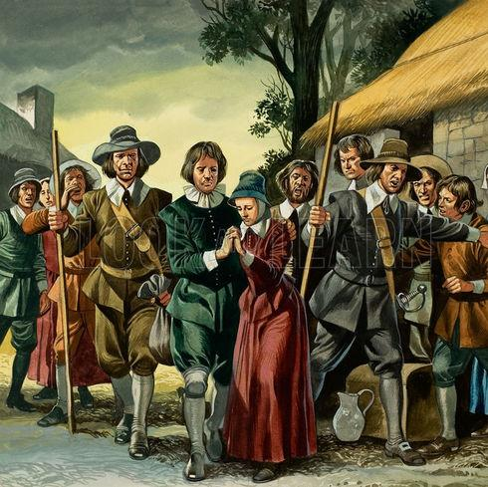
When the Separatist Pilgrims came to America, the Puritans remained within the Church of England
But when
the Catholic
King Charles I came to power, Puritans felt the time was right to leave Britain
In 1630, Puritans arrived in Boston & created the New England colony of Massachusetts

Slide 10
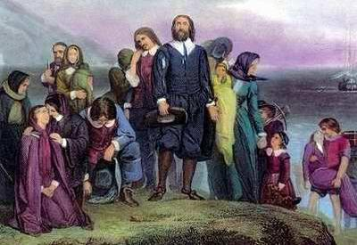
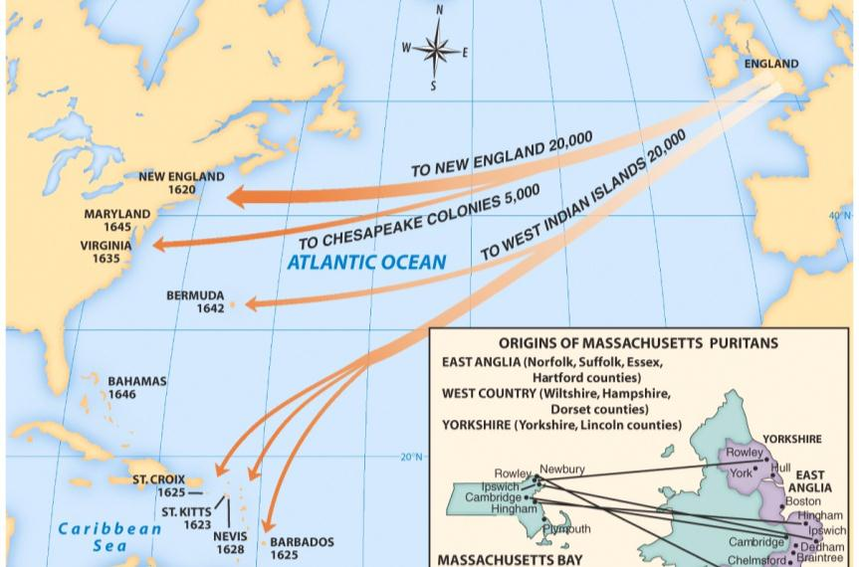
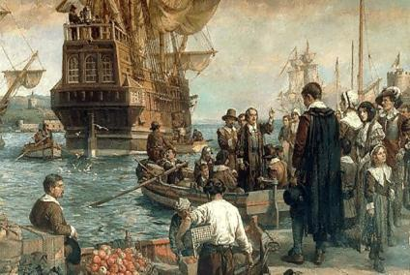
  From 1630 to 1640, Puritan leader John Winthrop led 16,000 Puritans to the Massachusetts Bay colony as part of the “Great Migration”
  John Winthrop wanted to build Boston as a
  “city on a hill” to be a model to other Christians

Slide 11
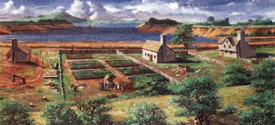
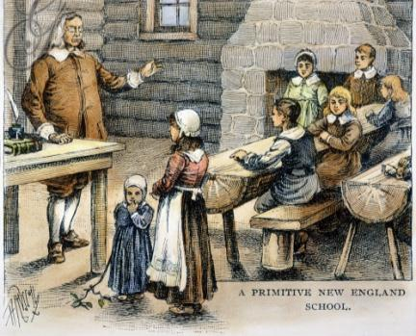
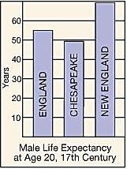
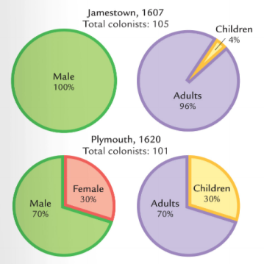
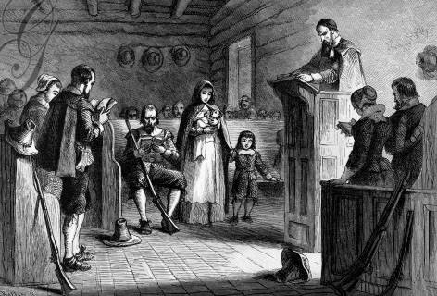
Quick discussion: Based on these images, how were the New England colonies different from Virginia?

Slide 12
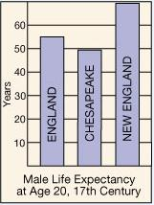
  Massachusetts was a different colony from Virginia:
Puritans came to America for religious freedom
Puritan settlers usually came as families
Settlers sacrificed for the common good, built schools, & focused on subsistence farming
New England was a more healthy place to live than Virginia so colonists lived longer

Slide 13
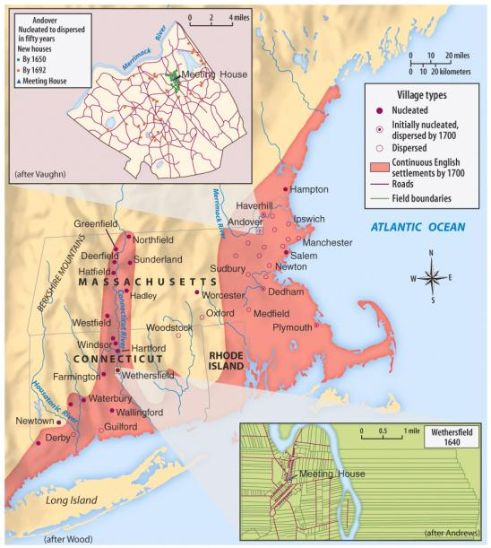

Government in in the New England colonies centered on the church through town meetings
Each New England town was independently governed by local church members
All adult male church members were allowed to vote for local laws & taxes
Notes:
Government in Massachusetts centered on the church through town meetings:
Each Massachusetts town was independently governed by local church members

Slide 14
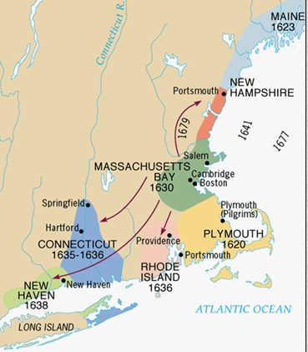
As the Massachusetts colony grew,
it spawned four new colonies:
New Hampshire, Rhode Island,
New Haven, & Connecticut
Connecticut
was important
for creating the first written constitution in
U.S. history called The Fundamental
Orders of Connecticut

Slide 15
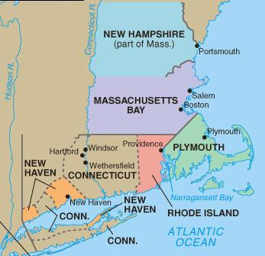
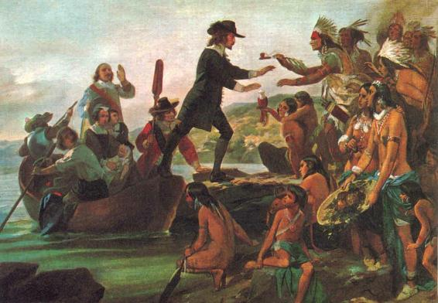
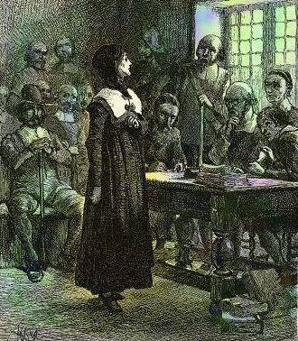
New England Puritans did not like ideas that differed from their own beliefs
Roger Williams was banished from Massachusetts for demanding that Indians be paid for their land;
He formed Rhode Island in 1636
Anne Hutchinson was banished for challenging Puritan authority

Slide 16
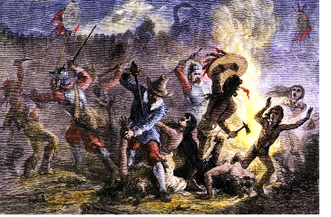
As the New England colonies expanded into new lands, conflicts with Indians arose
The Pequot War in 1637 was the 1st major British-led attack on Indians & led to the death of 600 Indians

Slide 17
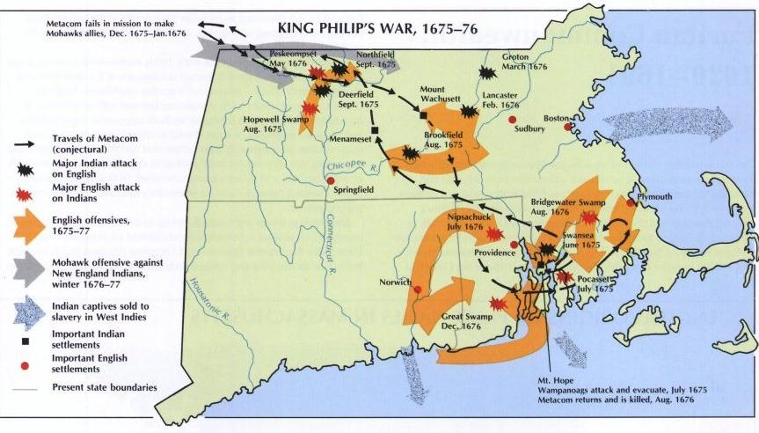
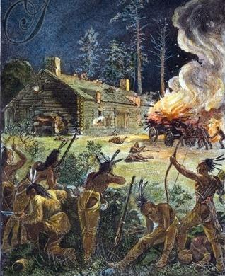
King Philip’s War broke out in 1675 when
the Wampanoag Indians raided towns,
killing 10% of the colonial New England men

Slide 18
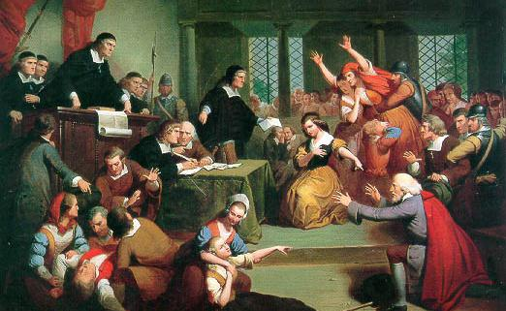
What might have caused the hysteria shown in this image?

Slide 19
By the 1660s,
many New England towns experienced a drop-off in
church membership
Churches responded with the Halfway Covenant which gave full church membership
to people who had not had a “conversion experience”
This compromise brought people back to the church, but showed the declining importance of religion in New England
Notes:
This compromise revealed the declining importance of religion in New England

Slide 20
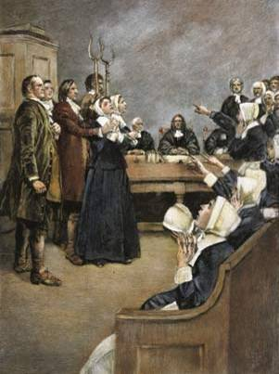
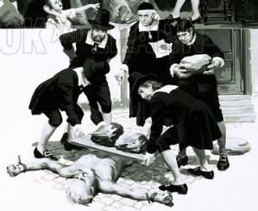
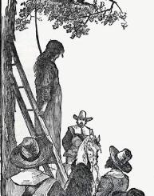
Religion played a role in the Salem
witchcraft trials in 1692 when several
young girls accused people of being witches
The hysteria was caused
by tensions over land ownership, Indian attacks, & religious disagreements
As a result of the trials,
19 people were killed & 150 citizens were jailed

Slide 21
Essential Question:
  What are the differences among the Chesapeake, New England, Middle, & Southern colonies?
  “Compare the British Colonies” notes

Slide 22
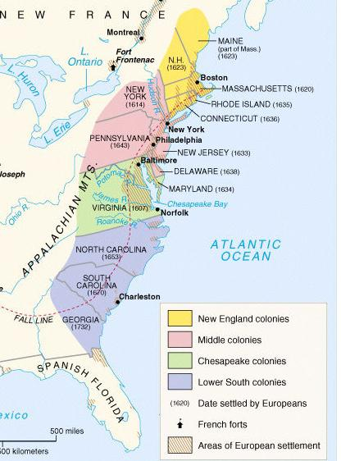
The
Middle &
Lower South Colonies
Notes:
Explain the development of the mid-Atlantic colonies; include the Dutch settlement of New Amsterdam and subsequent English takeover, and the settlement of Pennsylvania.

Slide 23
TO DO
Complete the EdPuzzle video ‘The Quakers, the Dutch, and the Ladies: Crash Course’ which was posted to GoogleClassroom
After you finish, complete the rest of the notes from this PowerPoint!

Slide 24
New York

Slide 25
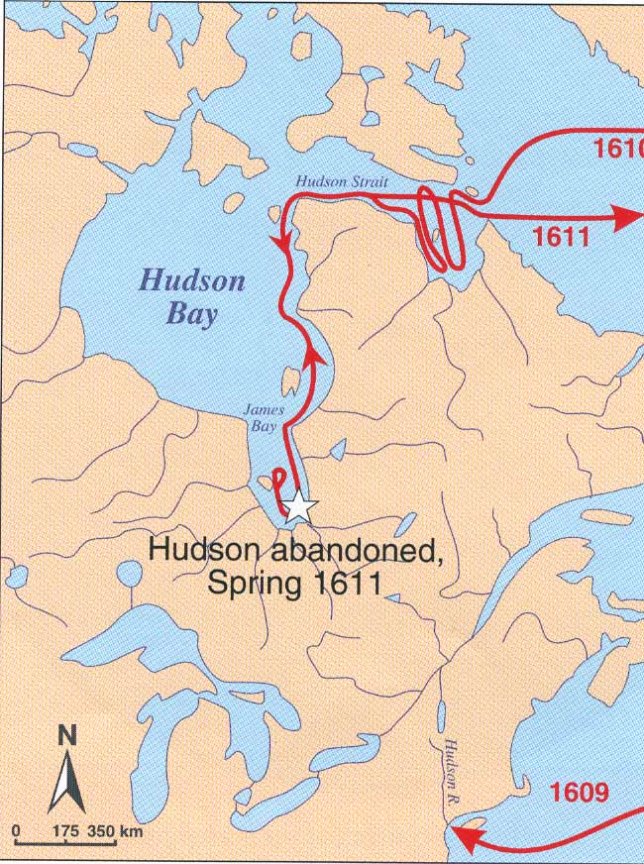
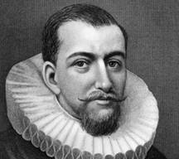
Henry Hudson’s Voyages

Slide 26
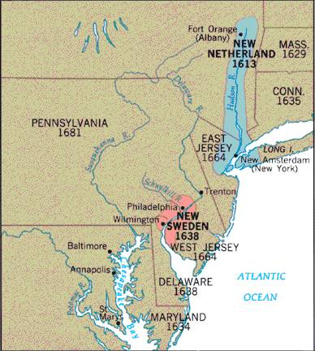
New Netherlands & New Sweden

Slide 27
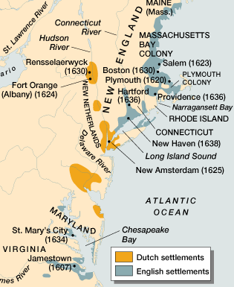
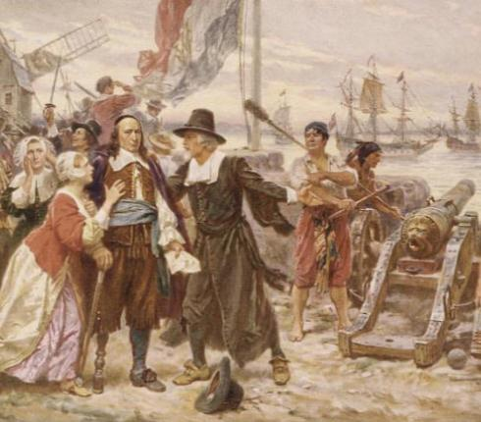
The 1st “middle” colony was New Netherland created by the Dutch West India Company
To attract settlers, the Dutch recruited Swedes, Germans, & Africans; New Netherland became very diverse
Britain did not like the Dutch owning a colony between their Chesapeake &
New England colonies
In 1664, Britain seized the Dutch colony from Governor Stuyvesant & renamed it New York
Dutch governor Peter Stuyvesant resisted Britain’s takeover of New Netherlands but could not get the colonists to assist him
Notes:
Explain the development of the mid-Atlantic colonies; include the Dutch settlement of New Amsterdam and subsequent English takeover, and the settlement of Pennsylvania.

Slide 28
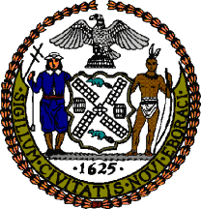
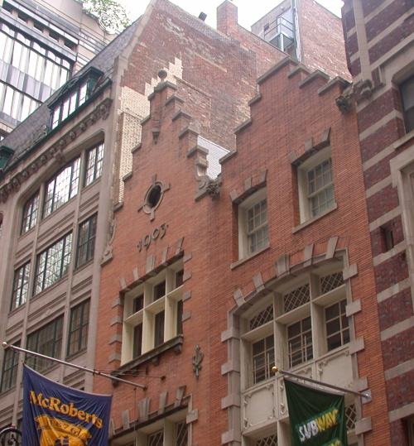
Dutch Residue in New York
Early 20^{c} Dutch Revival Building in NYC.
New York City
seal.
The Dutch controlled New Amsterdam from 1613-1664 and, as a result, Dutch culture made an imprint in the colony
Names → Harlem, Brooklyn
Architecture → gambrel roof
Customs → Easter eggs, Santa Claus, waffles, bowling, sleighing, skating, kolf [golf].

Slide 29
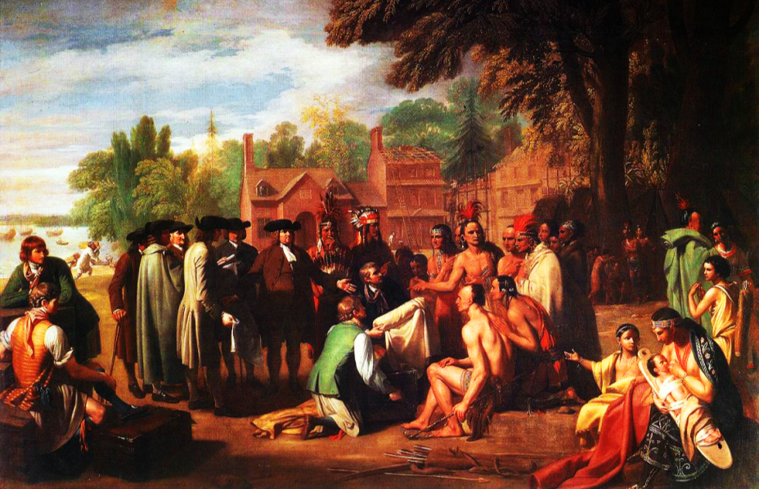
In what ways might Pennsylvania be different from other British colonies?

Slide 30
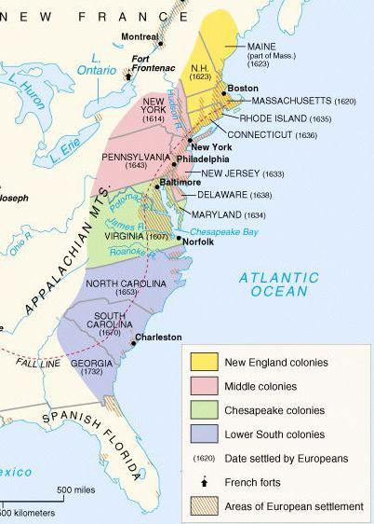
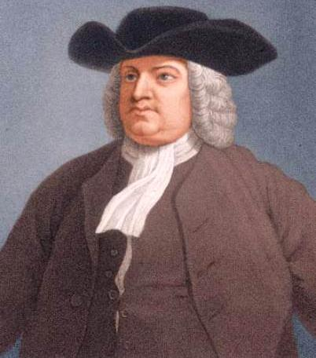
One of the most important middle colonies was Pennsylvania which was founded by William Penn in 1681

Slide 31
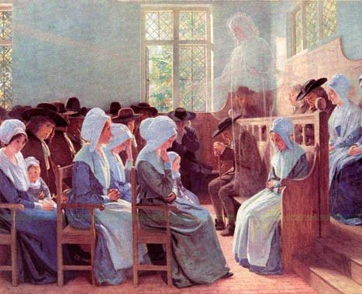
Penn was a member of
a religious sect called Quakers who believed
in the “Inner Light,” all people are equal, & that people can communicate directly with God

Slide 32
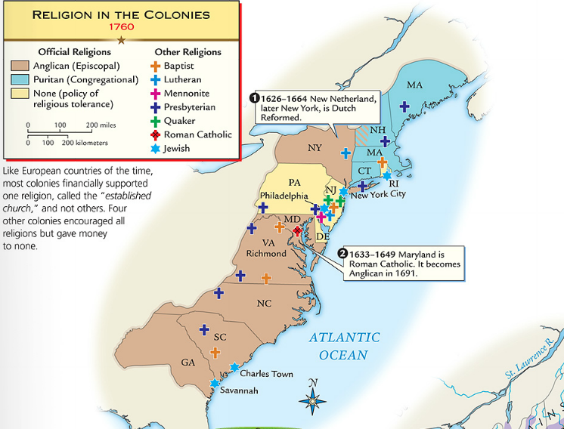
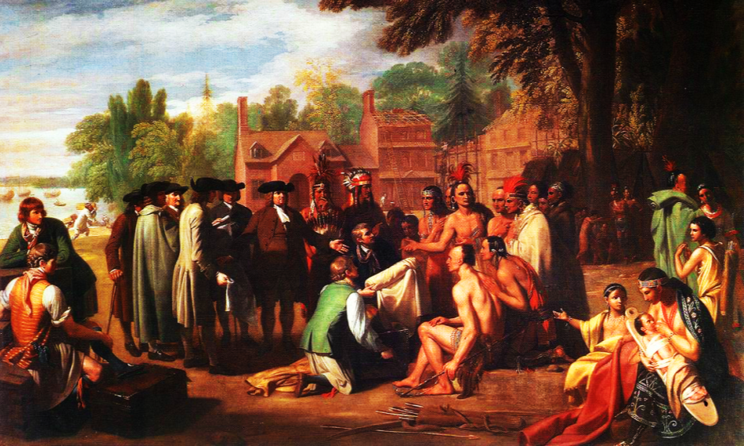
Penn founded his colony
as a “holy experiment” to promote religious toleration
He bought land from the Indians, banned slavery,
& allowed a diverse population to move there

Slide 33
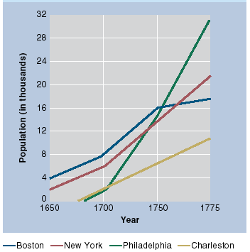
The middle colonies
had two of the best ports for trade in America: Philadelphia & New York

Slide 34
New Jersey

Slide 35
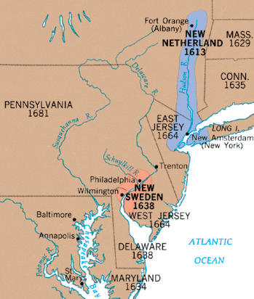
New Jersey — PA’s Neighbor
1664 → aristocratic proprietors received the area from the Duke of York.
Many New Englanders [because of worn out soil] moved to NJ.
  1674 → West NJ sold to Quakers.
  East NJ eventually acquired by Quakers.
1702 → E & W NJ combined into NJ and created one colony.

Slide 36
Delaware

Slide 37

Delaware — PA’s Neighbor
Named after Lord De La Warr [harsh military governor of VA in 1610].
Closely associated with Penn’s colony.
1703 → granted its own assembly.
Remained under the control of PA until the American Revolution.

Slide 38

The image below is from the “Lower South” colony of South Carolina. Which other colony might it be similar to? Why?

Slide 39




The Lower South colonies were the last British colonies to be formed
The Carolinas & Georgia developed like Virginia with a cash crop economy, slavery, & gaps between rich & poor colonists
Georgia was created by James Oglethorpe as a buffer colony between Carolina & Spanish Florida & was populated by British debtors & prisoners

Slide 40


Colonies like Barbados & Jamaica were profitable, producing sugar for Britain
In addition to the
13 colonies, Britain had colonies in the Caribbean

Slide 41
DO NOW
Finish any missing work for Unit 1.
Work on defining terms from the Unit 1 Study Guide which you received on the first day of class. You can use the study guide to help you study (imagine that!) AND you can earn extra credit on the test if you hand it in. Remember, the definitions must be hand-written and more than a simple one sentence definition to earn credit.
On Friday 2/14, we will finish Shark Tank, wrap-up unit 1, and your Unit 1 test will be Monday.

Slide 42
DO NOW
Finish any missing work
Work on Shark Tank. The items that you must have completed by start of class TUESDAY (NO CREDIT FOR LATE PROJECTS)
  Shark Tank GoogleSlides presentation
  SOTW Analysis Chart GoogleDoc completely filled in with 20 unique points of evidence shared with me (I will also accept a paper copy)
  On Shark Tank Presentation Notes and Questions GoogleDoc (3 questions typed up for EACH of the other groups…so a total of 15 questions) shared with me

Slide 43
DO NOW
Finish any missing work
Work on Shark Tank. The items that you must have completed by start of class TUESDAY (NO CREDIT FOR LATE PROJECTS)
  Shark Tank GoogleSlides presentation
  SOTW Analysis Chart GoogleDoc completely filled in with 20 unique points of evidence shared with me (I will also accept a paper copy)
  On Shark Tank Presentation Notes and Questions GoogleDoc (3 questions typed up for EACH of the other groups…so a total of 15 questions) shared with me

Slide 44
Shark Tank Presentations
Open your copy of the Shark Tank Presentation Notes and Questions GoogleDoc (link to it is on sprintz.weebly.com)
As each group presents, fill in what you liked, what concerned you about the investment, and potential for long-term growth of investment. Your 3 questions for each group should also be filled in.
After all groups present, fill in Final Rankings chart, and answer the Final Question
This completed Notes Sheet is worth 30 points of the 115 total points for the Shark Tank project
Turn in completed SOTW chart before you leave today (worth 10 points of the 120 points for project)
***Unit 1 test is Monday. Last time to turn in any late work for unit is at start of class Monday***

