Slide 1
Reconstruction
(1865-1876)

Slide 2
Key Questions
Who would control the process: Southern states, president, or Congress?
How to rebuild the South after its destruction during the War?
What would be the condition of African Americans in the South?
How would the South be reintegrated into the Union?

Slide 3
African-Americans in the immediate post-Civil War South

Slide 4
13th Amendment
Ratified in December, 1865.
Neither slavery nor involuntary servitude, except as punishment for crime whereof the party shall have been duly convicted, shall exist within the United States or any place subject to their jurisdiction.
Congress shall have power to enforce this article by appropriate legislation.

Slide 5
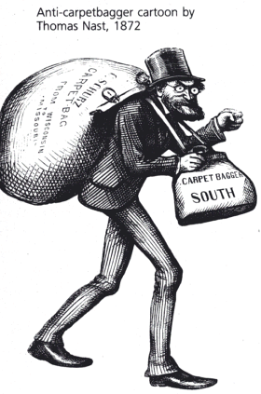
Freedmen’s Bureau (1865)
Bureau of Refugees, Freedmen, and Abandoned Lands.
Many former northern abolitionists risked their lives to help southern freedmen.
Called “carpetbaggers” by white southern Democrats.
Purpose: help unskilled, uneducated, poverty-stricken ex-slaves to survive
Provided food, clothing, medicine & education to ex-slaves & poor whites
Authorized to provide “40 acres & a mule” from confiscated or abandoned land to black settlers

Slide 6
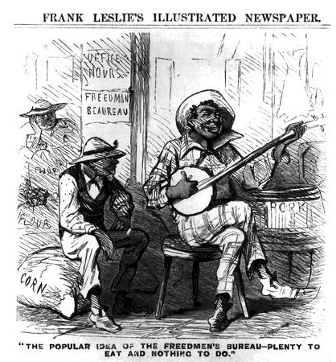
Freedmen’s Bureau Seen Through Southern Eyes
Plenty to eat and nothing to do.

Slide 7
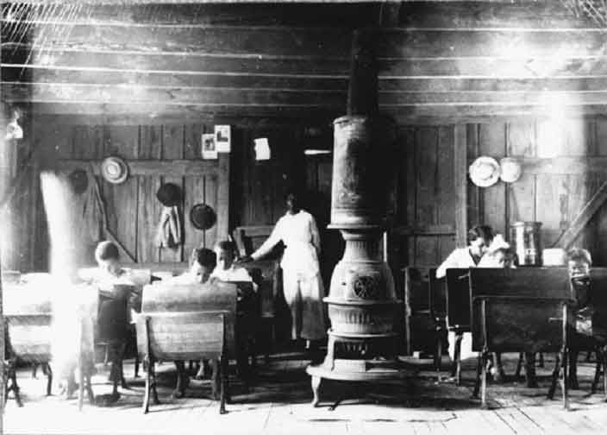
Freedmen’s Bureau School

Slide 8
Wartime
Reconstruction

Slide 9
President Lincoln’s Plan
10% Plan
Proclamation of Amnesty and Reconstruction (December 8, 1863)
Replace majority rule with “loyal rule” in the South.
He didn’t consult Congress regarding Reconstruction.
Pardon to all but the highest ranking military and civilian Confederate officers.
When 10% of the voting population in the 1860 election had taken an oath of loyalty and established a government, it would be recognized.

Slide 10
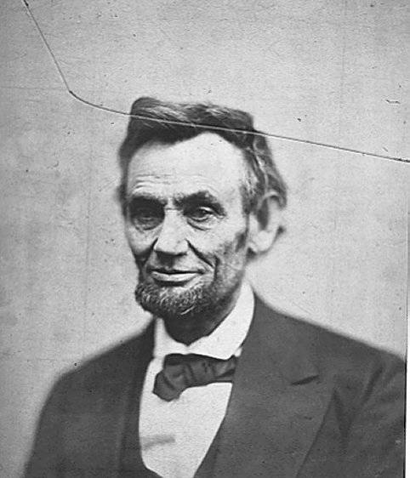
President Lincoln’s Plan
1864 → “Lincoln Governments” formed in LA, TN, AR
“loyal assemblies”: combination of freed slaves & northern republicans who had relocated to help facilitate Reconstruction
They were weak and dependent on the Northern army for their survival.

Slide 11
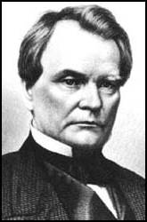
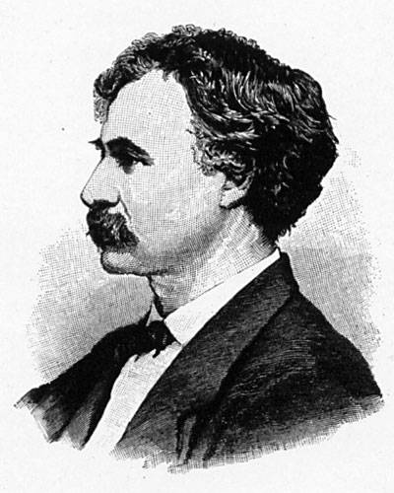
Wade-Davis Bill (1864)
Required 50% of the number of 1860 voters to take an “iron clad” oath of allegiance (swearing they had never voluntarily aided the rebellion ).
Required a state constitutional convention before the election of state officials.
Enacted specific safeguards of freedmen’s liberties.
Vetoed by Lincoln
Senator Benjamin Wade (R-OH)
Congressman Henry W. Davis (R-MD)

Slide 12
Wade-Davis Bill (1864)
“Iron-Clad” Oath: only those who’d take an oath attesting to past loyalty to the Union could vote or serve in state constitutional conventions
“State Suicide” Theory [MA Senator Charles Sumner]: Republican belief Confederate states had forfeited all their rights by seceding
“Conquered Provinces” Position [PA Congressman Thaddeus Stevens]: southern states should be readmitted subject to the conditions & wishes of Congress
Pocket Veto
President Lincoln
Wade-Davis Bill

Slide 13
Presidential
Reconstruction

Slide 14
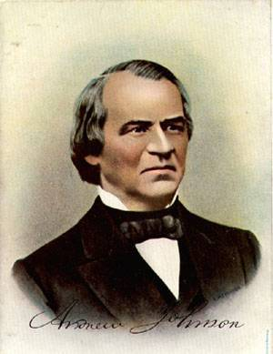
President Andrew Johnson
Jacksonian Democrat.
Anti-Aristocrat.
White Supremacist.
Agreed with Lincoln that states had never legally left the Union.
Damn the negroes! I am fighting these traitorous aristocrats, their masters!

Slide 15
President Johnson’s Plan (10%+)
Offered amnesty upon simple oath to all except Confederate civil and military officers and those with property over $20,000 (they could apply directly to Johnson)
In new constitutions, they must accept minimum conditions repudiating slavery, secession and state debts.
Named provisional governors in Confederate states and called them to oversee elections for constitutional conventions.
1. Disenfranchised certain leading Confederates.
EFFECTS?
2. Pardoned planter aristocrats & brought them back to political power to control state organizations.
3. Republicans were outraged that planter elite were back in power in the South!

Slide 16
Growing Northern Alarm!
Many Southern state constitutions fell short of minimum requirements.
Johnson granted 13,500 special pardons.
Revival of southern defiance.
BLACK CODES

Slide 17
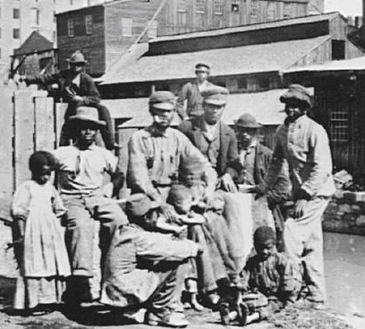
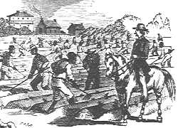
Black Codes
Purpose:
Guarantee stable labor supply now that blacks were emancipated.
Restore pre-emancipation system of race relations.
Forced many blacks to become sharecroppers [tenant farmers].
Severe penalties on those who “jumped” labor contracts
Vagrancy laws; limits on renting/leasing land

Slide 18
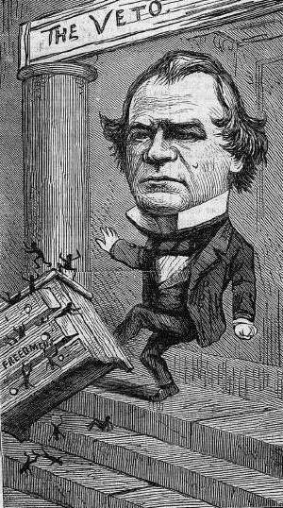
Congress Breaks with the President
Congress bars Southern Congressional delegates.
Joint Committee on Reconstruction created.
February, 1866 → President vetoed the Freedmen’s Bureau bill.
March, 1866 → Johnson vetoed the 1866 Civil Rights Bill which provided that: “…all persons born in the U.S. …are hereby declared to be…citizens of the U.S.”; intent of bill was to destroy Black Codes
Congress passed both bills over Johnson’s vetoes → 1st in U. S. history!!

Slide 19
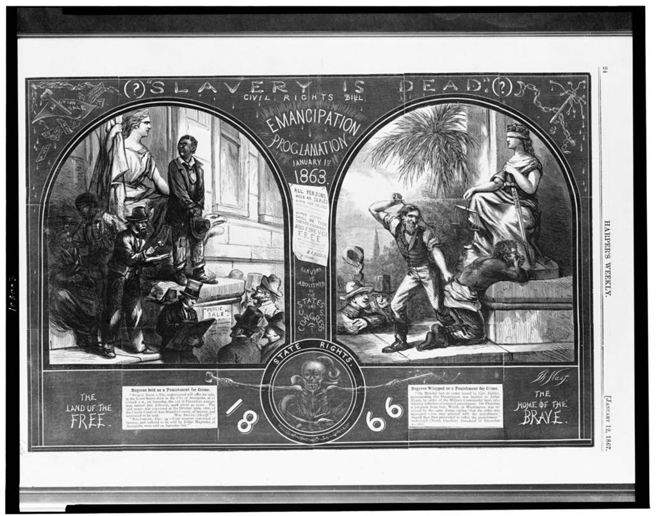
Slavery is Dead?

Slide 20
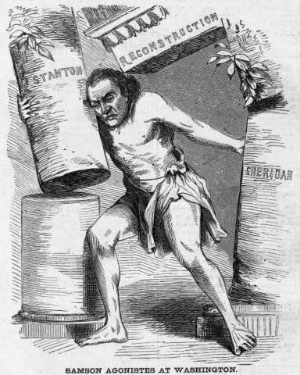
Johnson the Martyr / Samson
If my blood is to be shed because I vindicate the Union and the preservation of this government in its original purity and character, let it be shed; let an altar to the Union be erected, and then, if it is necessary, take me and lay me upon it, and the blood that now warms and animates my existence shall be poured out as a fit libation to the Union. (February 1866)

Slide 21
Radical
(Congressional)
Reconstruction

Slide 22
14th Amendment
Ratified in July, 1868.
Provide a constitutional guarantee of the rights and security of freed people.
Insure against neo-Confederate political power.
Enshrine the national debt while refusing assumption of Confederate state’s debt.
Southern states would be punished for denying the right to vote to black citizens!
After Reconstruction ended, southern states passed Jim Crow laws institutionalizing segregation which violated the equal protection clause of the 14th Amend.

Slide 23
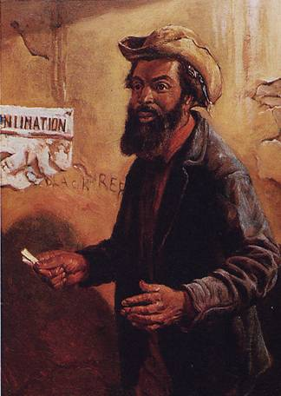
The Balance of Power in Congress (1866)
State | White Citizens | Freedmen
SC | 291,000 | 411,000
MS | 353,000 | 436,000
LA | 357,000 | 350,000
GA | 591,000 | 465,000
AL | 596,000 | 437,000
VA | 719,000 | 533,000
NC | 631,000 | 331,000

Slide 24
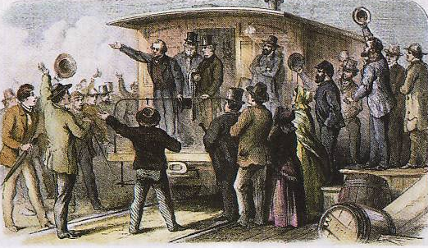
The 1866 Mid-term Election
A referendum on Radical Reconstruction.
Johnson made an ill-conceived propaganda tour around the country to push his plan.
Republicans won a 3-1 majority in both houses and gained control of every northern state.
Johnson’s “Swing around the Circle”

Slide 25
Radical Plan for Readmission
Civil authorities in the territories were subject to military supervision.
Required new state constitutions, including black suffrage and ratification of the 13th and 14th Amendments.
In March, 1867, Congress passed an act that authorized the military to enroll eligible black voters and begin the process of constitution making.

Slide 26
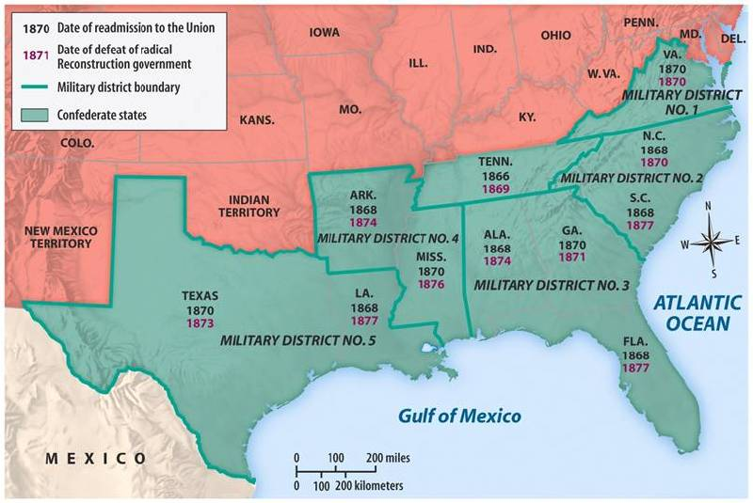
Reconstruction Acts of 1867
Military Reconstruction Act
Restart Reconstruction in the 10 Southern states that refused to ratify the 14th Amendment.
Divide the 10 “unreconstructed states” into 5 military districts.

Slide 27
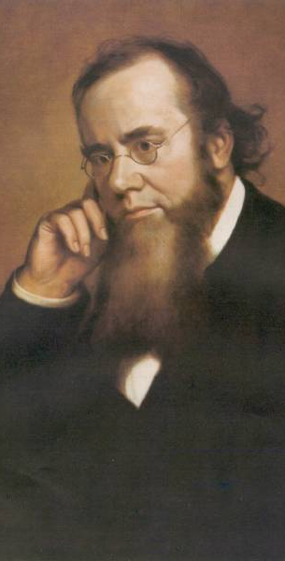
Reconstruction Acts of 1867
Command of the Army Act
The President must issue all Reconstruction orders through the commander of the military.
Tenure of Office Act
The President could not remove any officials [esp. Cabinet members] without the Senate’s consent, if the position originally required Senate approval.
Designed to protect radical members of Lincoln’s government.
A question of the constitutionality of this law.
Sec. of War
Edwin Stanton

Slide 28
President Johnson’s Impeachment
Johnson removed Stanton in February, 1868.
Johnson replaced generals in the field who were more sympathetic to Radical Reconstruction.
The House impeached him on February 24 before even drawing up the charges by a vote of 126 – 47!

Slide 29
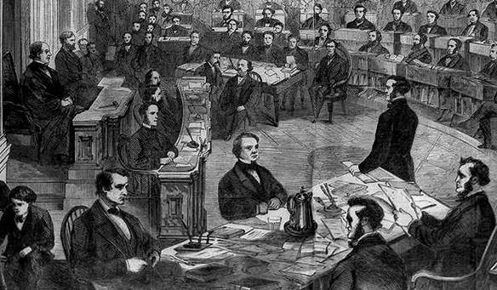
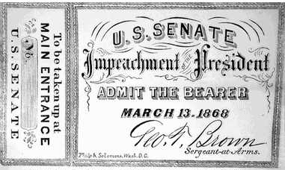
The Senate Trial
11 week trial.
Johnson acquitted 35 to 19 (one short of required 2/3s vote).

Slide 30
15th Amendment
Ratified in 1870.
The right of citizens of the United States to vote shall not be denied or abridged by the United States or by any state on account of race, color, or previous condition of servitude.
The Congress shall have power to enforce this article by appropriate legislation.
Purposes: ensure guarantees of suffrage if southerners took control of Congress; strengthen Republican control of southern states
Women’s rights groups were furious that they were not granted the vote!

Slide 31
15th Amendment: LOOPHOLES
Amendment said nothing about HOLDING office
Voting requirements weren’t uniform around the country
Poll taxes, literacy tests, and property requirements weren’t addressed
Grandfather clauses est. to reduce black voters; required citizenship prior to 14th Amendment
Gerrymandering
Intimidation including lynching
RESULT:
Democratic dominance in South assured
14th & 15th Amendments were ignored; many southern Republican voters were also denied suffrage
Full suffrage for blacks not realized until 1965!

Slide 32
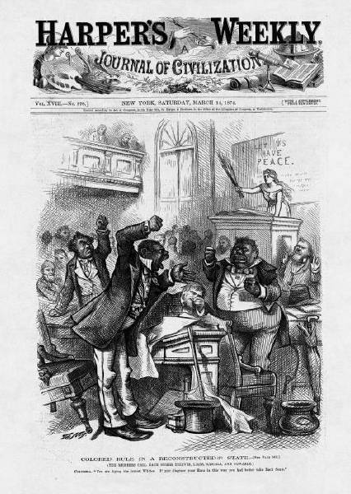
Colored Rule in the South?

Slide 33
The Civil Rights Act of 1875
Crime for any individual to deny full & equal use of public conveyances and public places.
Prohibited discrimination in jury selection.
Shortcoming → lacked a strong enforcement mechanism.
No new civil rights act was attempted for 90 years!

Slide 34
The
Abandonment
of Reconstruction

Slide 35
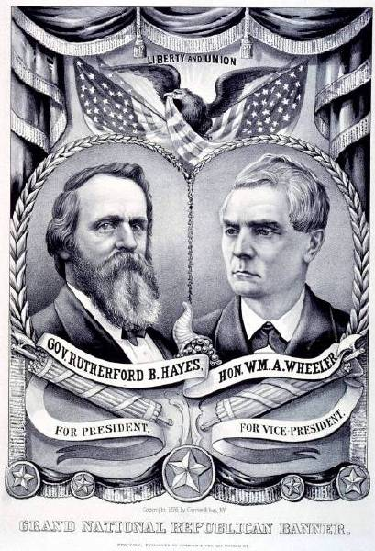
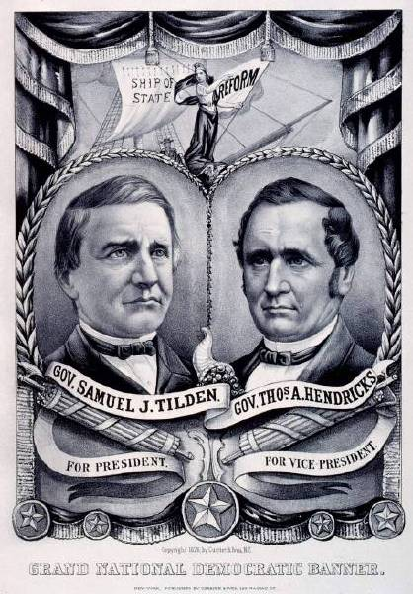
1876 Presidential Tickets

Slide 36
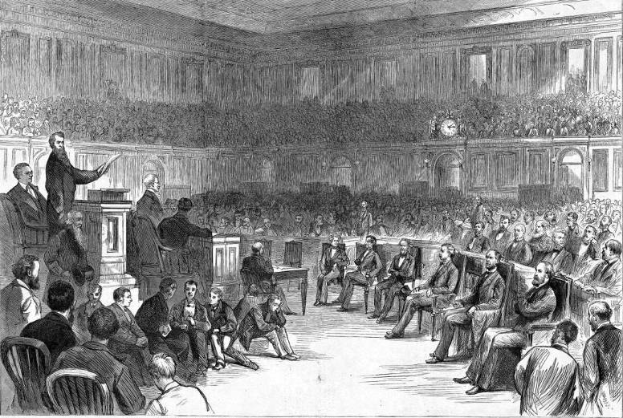
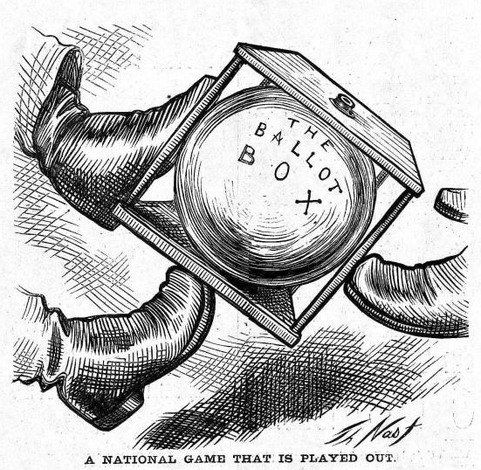
The Political Crisis of 1877
“Corrupt Bargain” Part II?
Tilden (D) led in popular vote & 184-165 in electoral vote; 185 needed to win
20 electoral votes from SC, FL, & LA in question

Slide 37
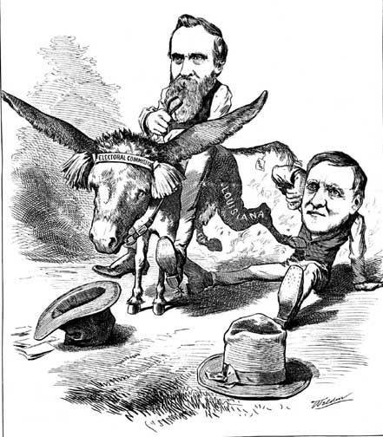
Hayes Prevails

Slide 38
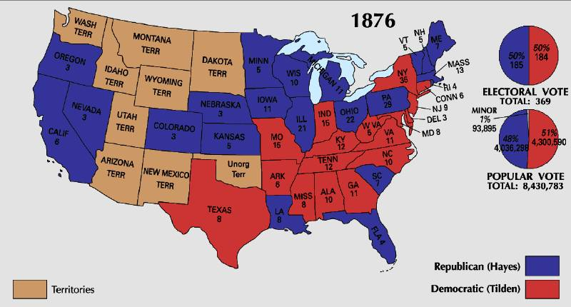
1876 Presidential Election

Slide 39
A Political Crisis: The “Compromise” of 1877

Slide 40
Black
"Adjustment"
in the South

Slide 41
Radical Reconstruction in the South

Slide 42
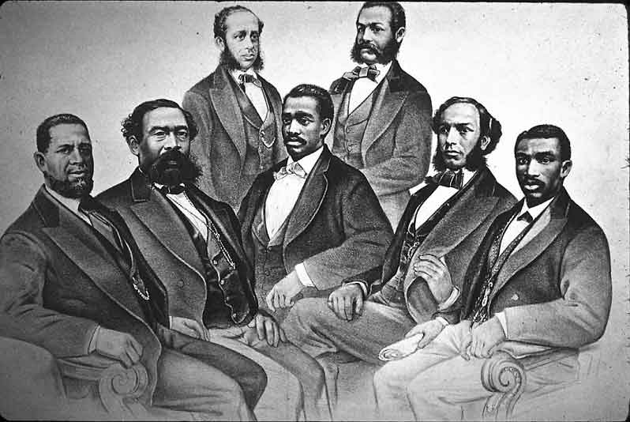
Black Senate & House Delegates
Mississippi elected 2 black Senators: Hiram Revels (1870-71) & Blanche K. Bruce ( 1875-81)
"First Colored Senator and Representatives in the 41st and 42nd Congress of the United States." (Left to right) Senator Hiram Revels of Mississippi, Representatives Benjamin Turner of Alabama, Robert DeLarge of South Carolina, Josiah Walls of Florida, Jefferson Long of Georgia, Joseph Rainey and Robert B. Elliot of South Carolina. By Currier and Ives, 1872 Courtesy of the Library of Congress

Slide 43
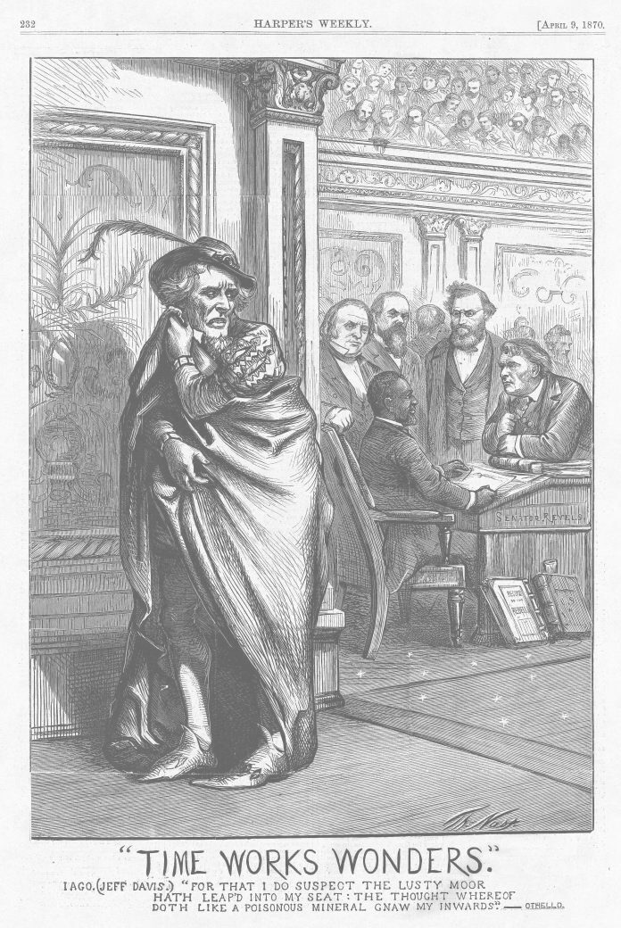
Revels (seated) replaces Jefferson Davis (left; dressed as Iago from William Shakespeare's Othello) in US Senate.
Source: Harper's Weekly Feb. 19, 1870. Davis had been a senator from Mississippi until 1861.
“Time Works Wonders.”
Iago (Jeff Davis) “For that I do suspect the lusty Moor hath leapd into my seat; The thought whereof doth like a poisonous mineral gnaw my innards”

Slide 44
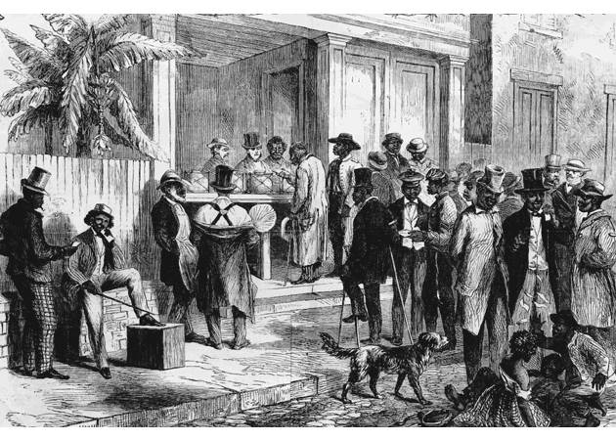
Blacks in Southern Politics
Core voters were black veterans.
Blacks were politically unprepared.
Blacks could register and vote in states since 1867.
The 15th Amendment guaranteed federal voting.

Slide 45
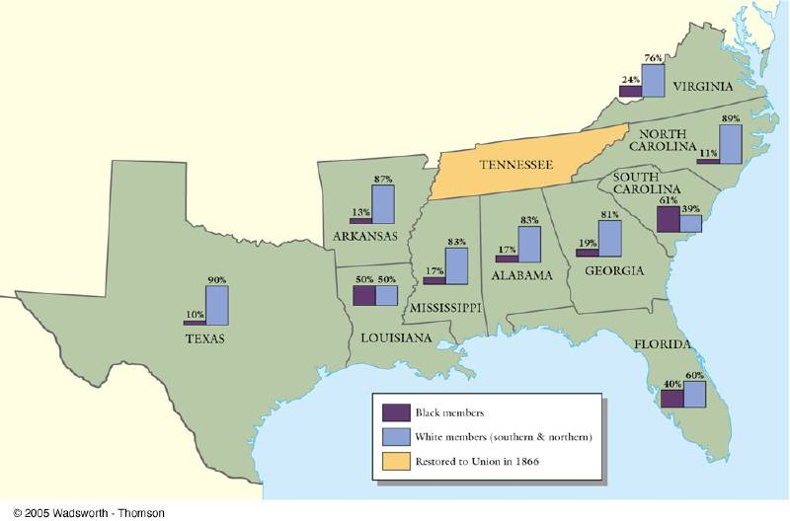
Black & White Political Participation

Slide 46
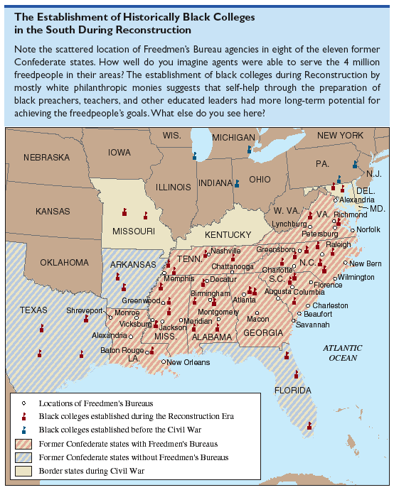
Establishment of Historically Black Colleges in the South

Slide 47
Corruption in State Legislatures
Scalawags
-native white southerners who cooperated with the Republicans
Carpetbaggers
“Since reconstruction, the masses of my people have been, as it were, enslaved in mind by unprincipled adventurers, who, caring nothing for country, were willing to stoop to anything no matter how infamous, to secure power to themselves, and perpetuate it..... My people have been told by these schemers, when men have been placed on the ticket who were notoriously corrupt and dishonest, that they must vote for them; that the salvation of the party depended upon it; that the man who scratched a ticket was not a Republican. This is only one of the many means these unprincipled demagogues have devised to perpetuate the intellectual bondage of my people.... The bitterness and hate created by the late civil strife has, in my opinion, been obliterated in this state, except perhaps in some localities, and would have long since been entirely obliterated, were it not for some unprincipled men who would keep alive the bitterness of the past, and inculcate a hatred between the races, in order that they may aggrandize themselves by office, and its emoluments, to control my people, the effect of which is to degrade them.”
– Hiram Revels in letter to Republican Ulysses S. Grant, Nov. 6, 1875

Slide 48
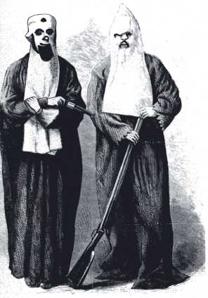
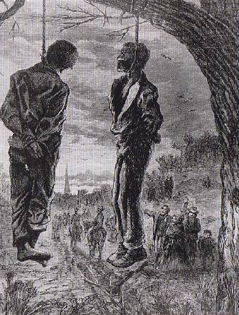
The “Invisible Empire of the South”

Slide 49
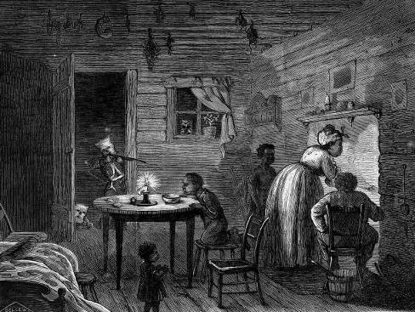
The Failure of Federal Enforcement
Enforcement Acts of 1870 & 1871 [also known as the KKK Act].
Amnesty Act of 1872: returned voting rights & right to hold office to 150,000 former Confederates who’d lost them when 14th Amendment was ratified
“The Lost Cause”: Southern white resentment & humiliation continued & led to violence & discrimination toward African-Americans
Redeemers (prewar Democrats and Union Whigs) -rejected legitimacy of the slavery amendments; believed rights of freed slaves COULD still be restricted

Slide 50
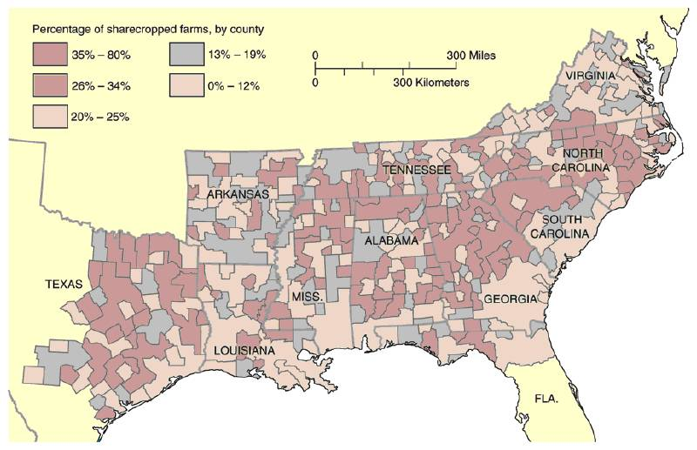
Sharecropping
Replaced slave labor plantation system
Crop-lien laws passed to tie African-Americans to plantation owners by forcing them into perpetual debt

Slide 51
Tenancy & the Crop Lien System
Furnishing Merchant | Tenant Farmer | Landowner
Loan tools and seed up to 60% interest to tenant farmer to plant spring crop. Farmer also secures food, clothing, and other necessities on credit from merchant until the harvest. Merchant holds “lien” {mortgage} on part of tenant’s future crops as repayment of debt. | Plants crop, harvests in autumn. Turns over up to ½ of crop to land owner as payment of rent. Tenant gives remainder of crop to merchant in payment of debt. | Rents land to tenant in exchange for ¼ to ½ of tenant farmer’s future crop.

